Slide 1
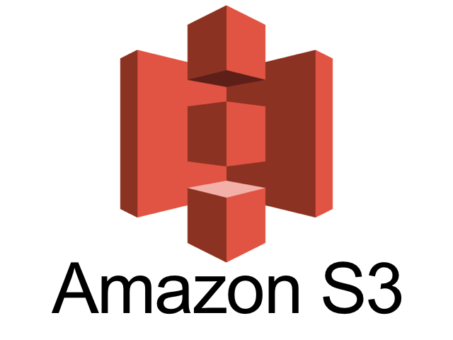

Understanding Amazon S3 and the NI Cloud Toolkit for AWS
John R. Leeman
NI ALARM September Meeting

Slide 2
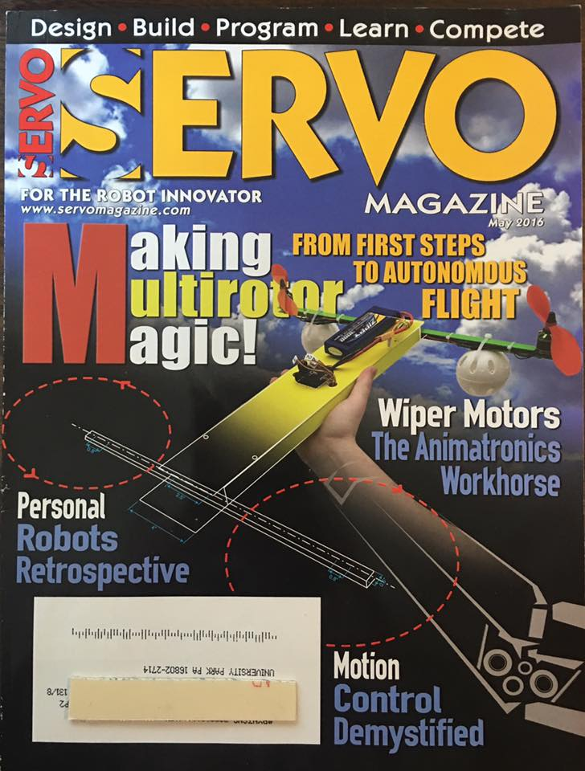
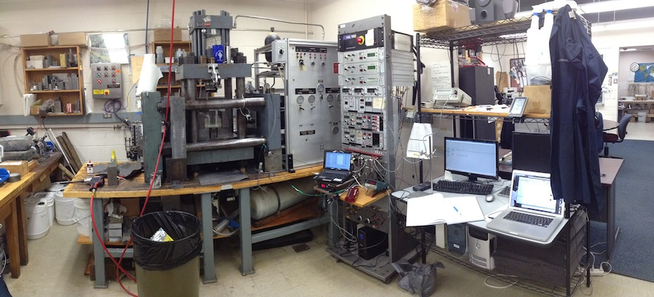








First a quick introduction…

Slide 3

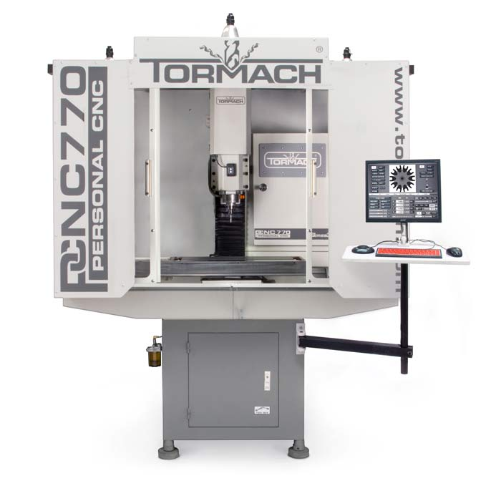
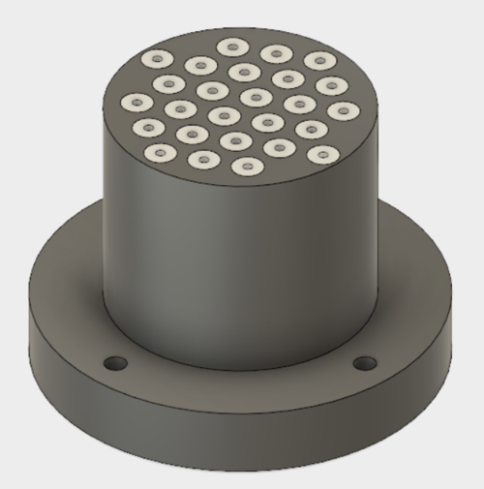

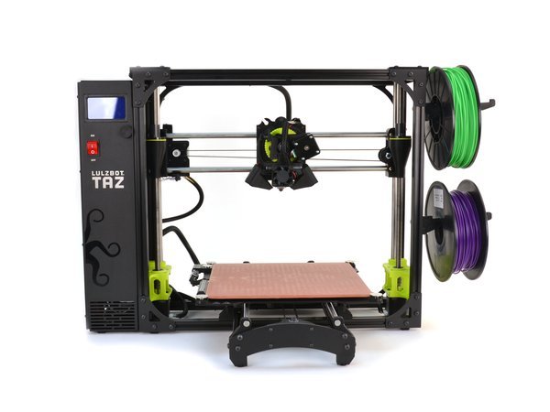
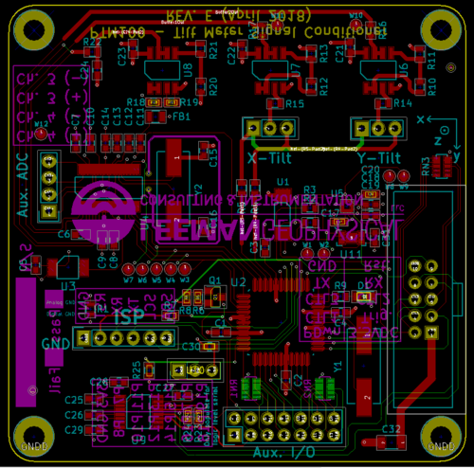
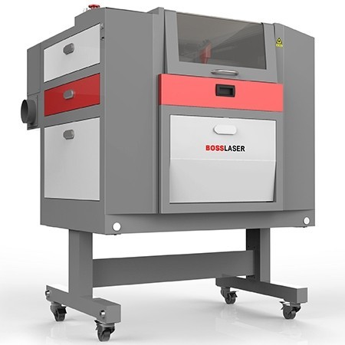
I also run an instrument company

Slide 4
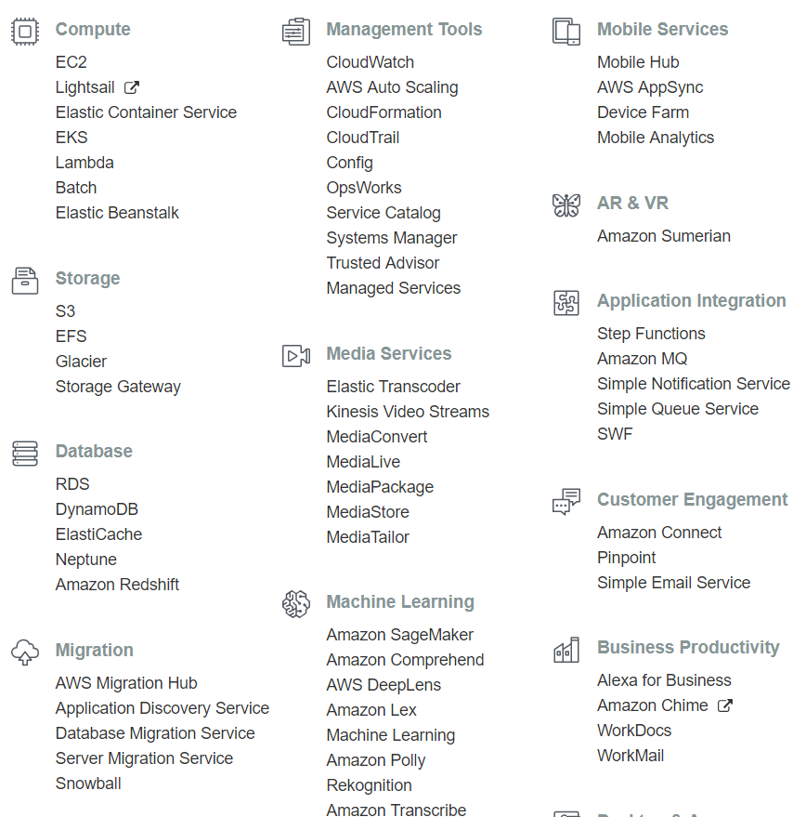
Amazon Web Services comprises a HUGE suite of products

Slide 5
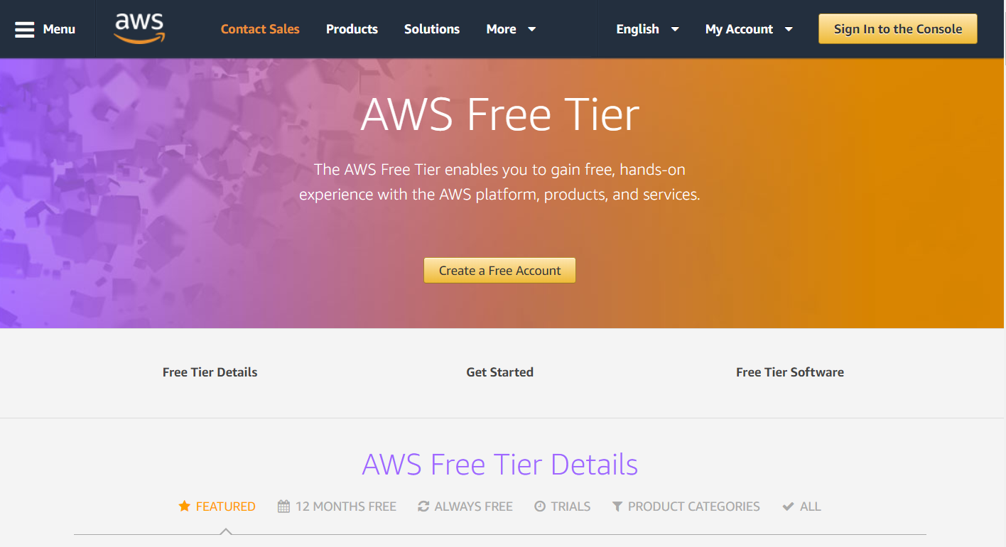
You’ll need to sign up for an AWS account, the free tier of services is really pretty amazing

Slide 6

Specifically, today I’ll focus on the S3 service
Simple Storage Service
Up to 100 buckets by default
Very inexpensive
Scalable
Secure

Slide 7
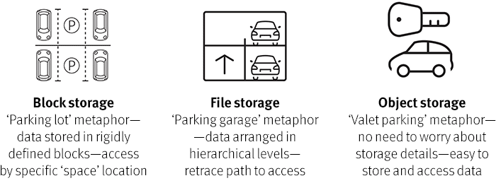
S3 is an object store and is locked down by default

Slide 8

Let trained professionals take care of the details

Slide 9
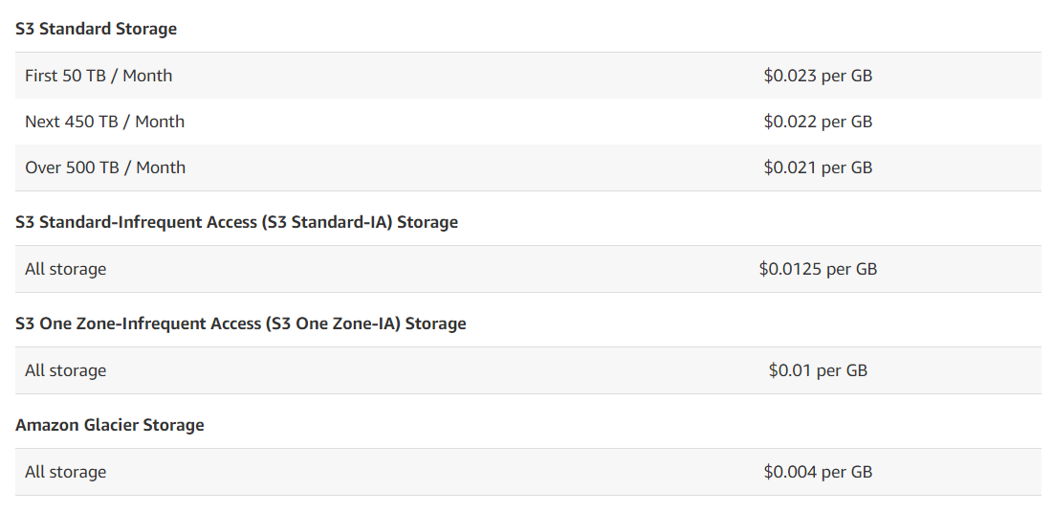
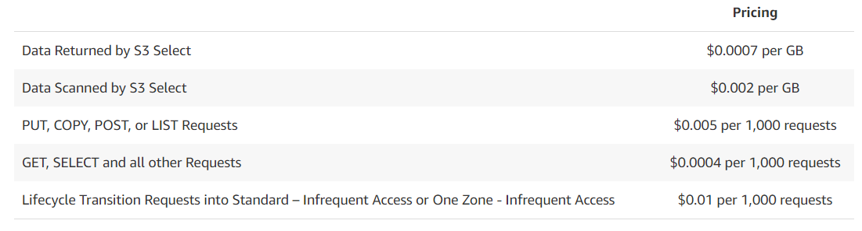
Let’s look at cost

Slide 10

The most confusing part of AWS is the IAM and actually being able to get to things

Slide 11
Let’s create an IAM user and give it access to the S3 service – nice and secure.

Slide 12
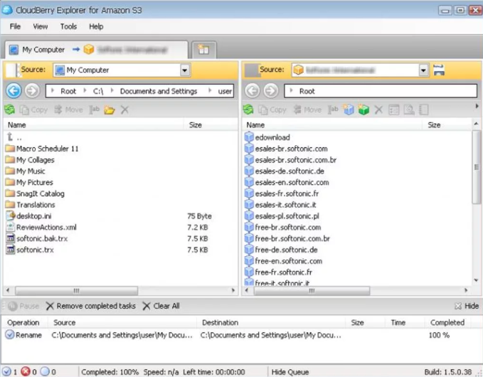
I recommend CloudBerry S3 Explorer for working with S3 buckets and services

Slide 13
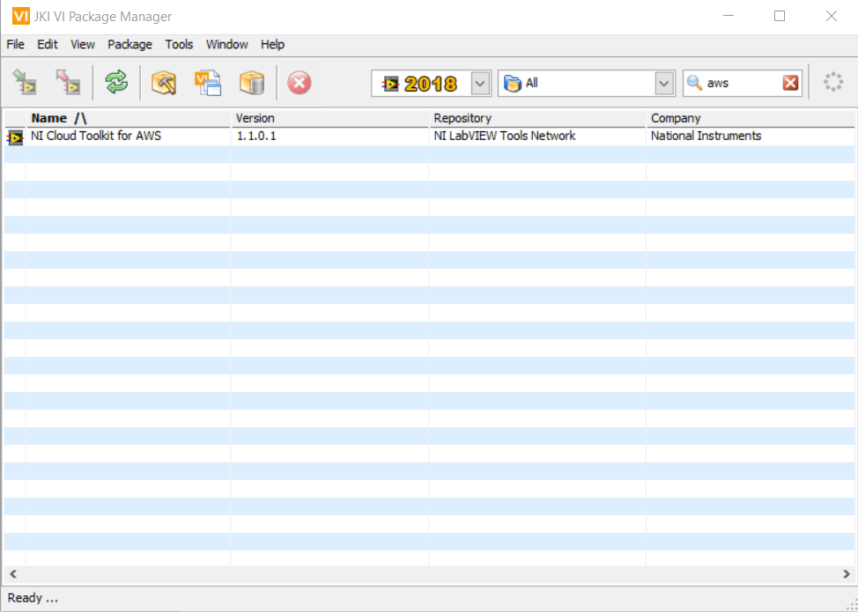
To work with S3 from LabView, we’ll need the NI Cloud Toolkit for AWS

Slide 14
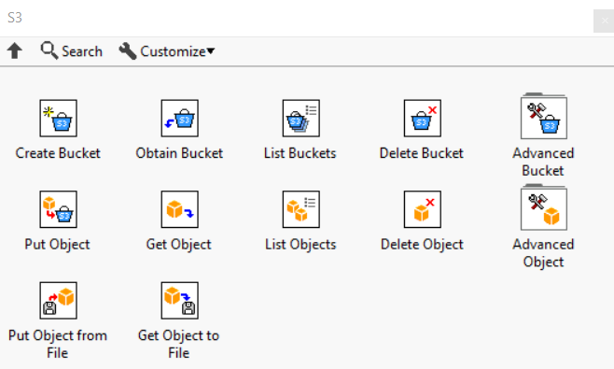
There are SNS, SQS, and IoT services in the toolkit in addition to the S3 tools

Slide 15
As with any service there are uses and abuses
Uses
Poll and work with data that are periodically updated
Post analysis results for real time use/sharing by stakeholders
Create static web output
Avoid local storage, working with data in RAM/cache
Abuses
This isn’t a database!
Lots of puts/gets can get expensive quickly (tiled data much?)
Can be hazardous/expensive if just “opened up”

Slide 16
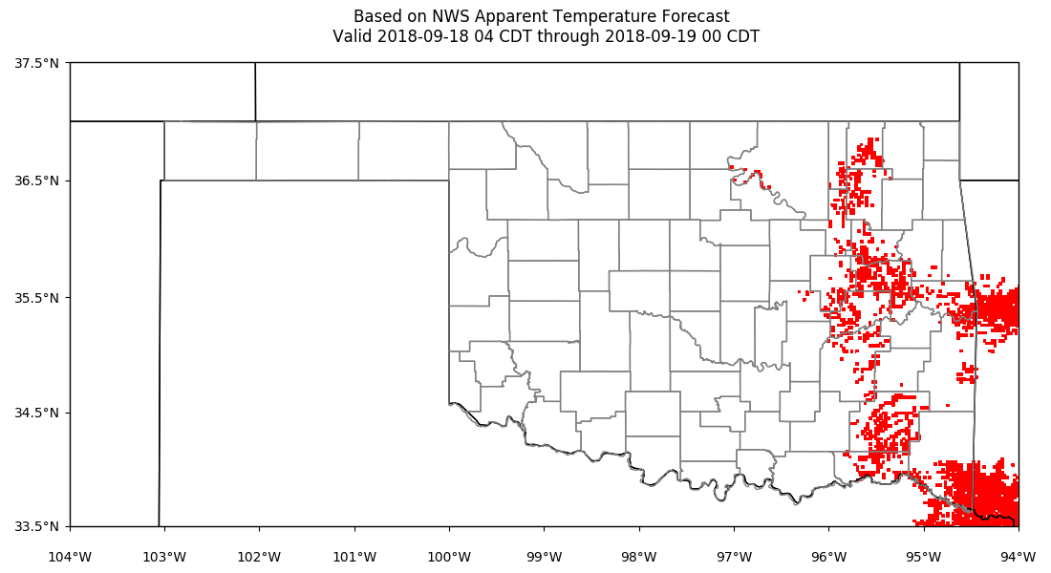

Slide 17
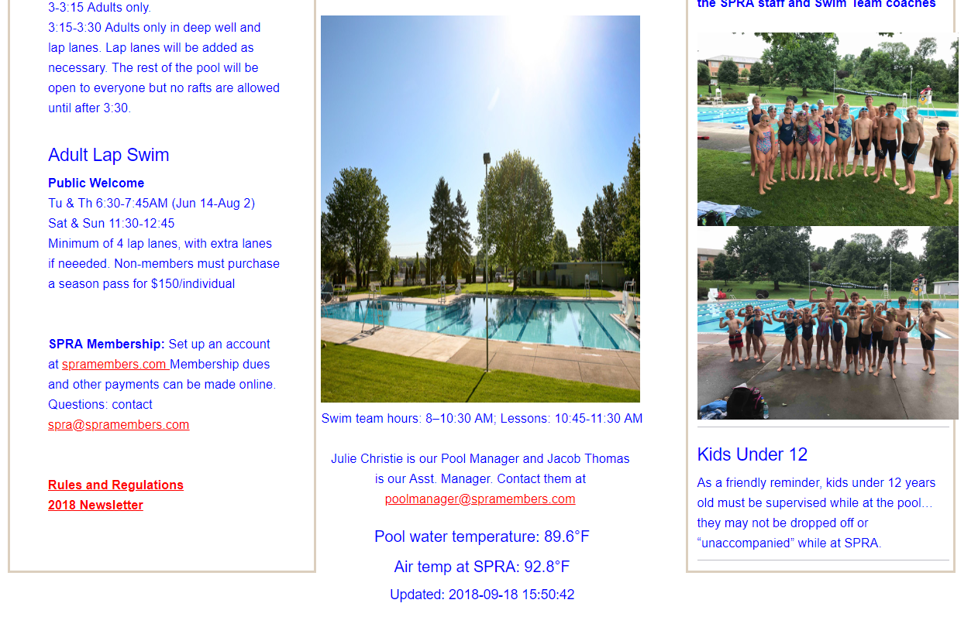

Slide 18

Demo time!

